Slide 1
What Is It?
Robotic Process Automation
Automation for business operations across applications
Software that can use other software so you don’t have to
Takes care of basic, repetitive tasks
Works like a digital assistant
You are already using it (kind of)
Alexa / Google Assistant
ChatOps / form letters / automated emails
Spelling and grammar checkers
Code generators (RAILS, Initializr, etc)
Distributed Tracing (ELK, Splunk)
Automated ticket booking, change of address, etc

Slide 2
Advantages
“The more you automate, the more you can automate”
-- Henry Ford
Reduced costs
Improved accuracy
More tasks are open to analytics
Improved employee engagement
Well defined governance agents
Removes pain points from clients and employees
Knowledge is retained within the systems
Reduces burden on IT by using currently installed tools

Slide 3
RPA: An Overview
U.S. Securities and Exchange Commission

Slide 4
Operations
Interact with other systems
Screen scraping
API
Decision system to determine actions
AI / ML
Script
Interface to program the bot
Automated learning
Scripting
Record macros
Code free
Rules engines
Crystallized Knowledge
Process is contained in the system
Automated governance
Onboarding is more automatic
Performance metrics become available
Integrates with AI
Chatbots
OCR / NLP

Slide 6
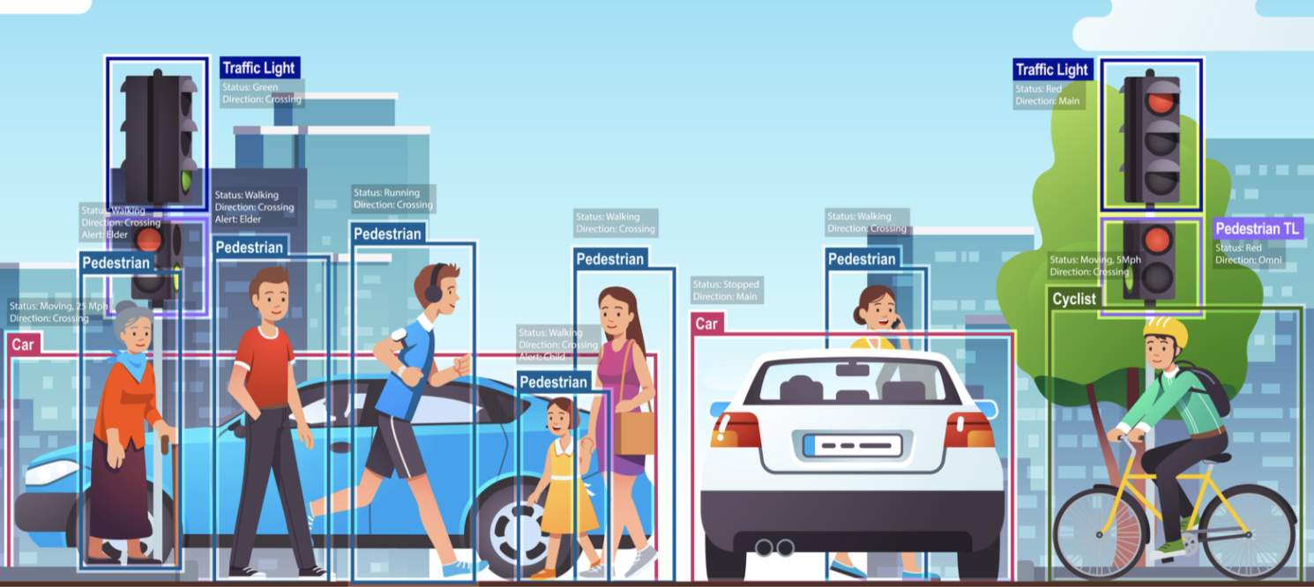
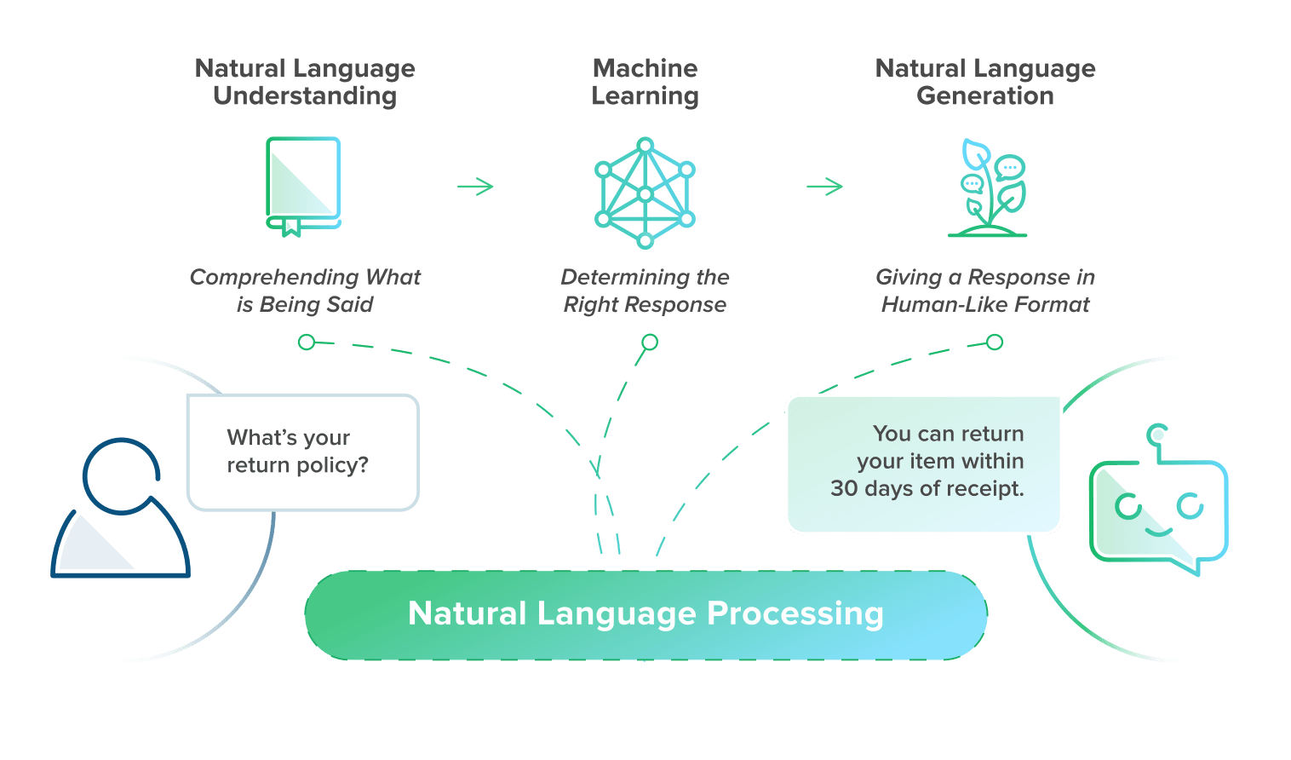
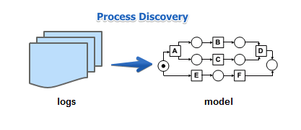
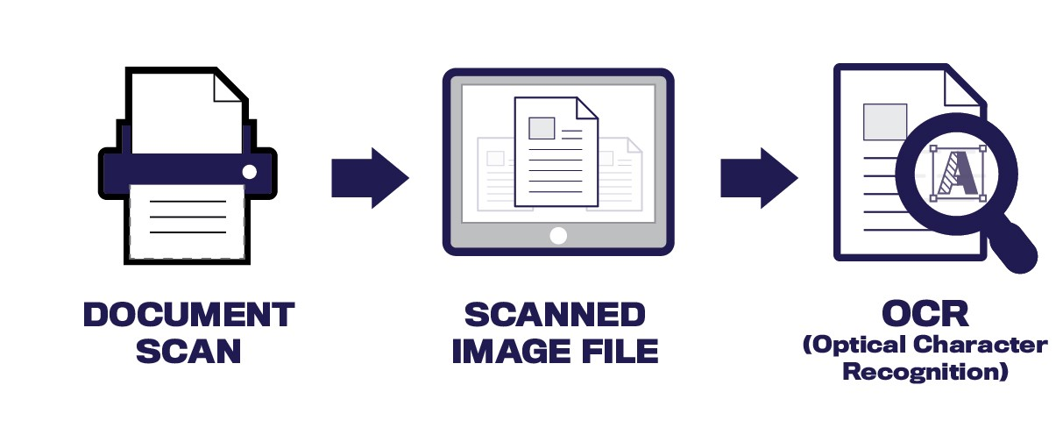
RPA + Machine Learning & Artificial Intelligence
Computer Vision
Optical Character Recognition
Natural Language Processing
Task Mining/Process Discovery

Slide 7
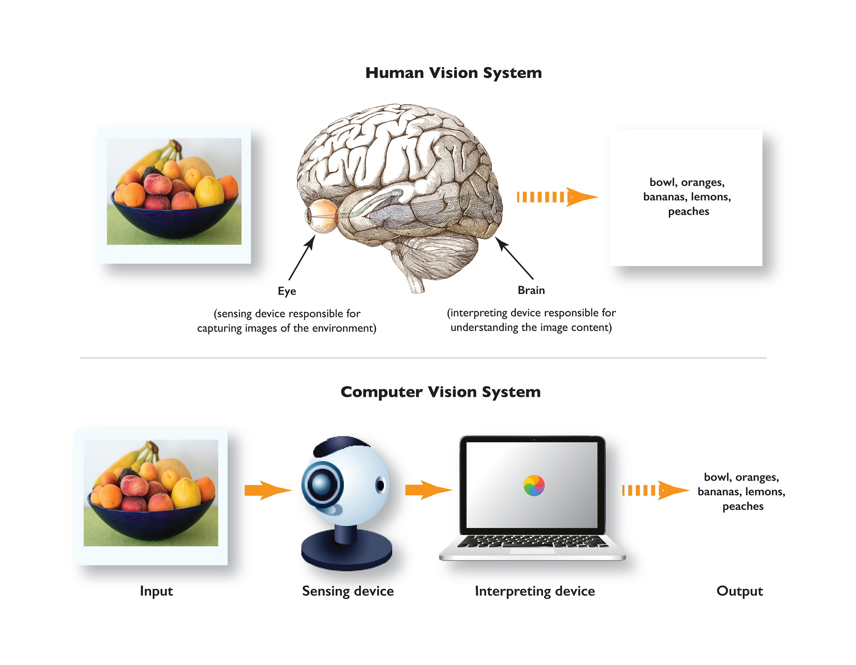
Use Case – Computer Vision
Computer Vision: Analysis of visual data (images/videos) to detect objects, classify pictures and extract insights

Slide 8
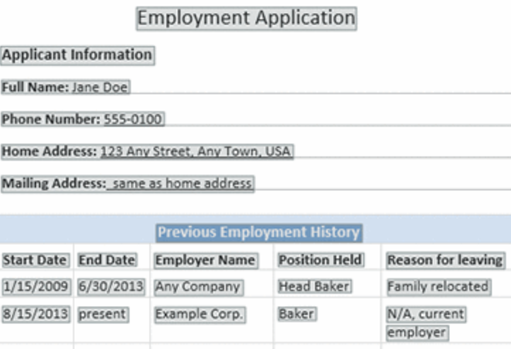
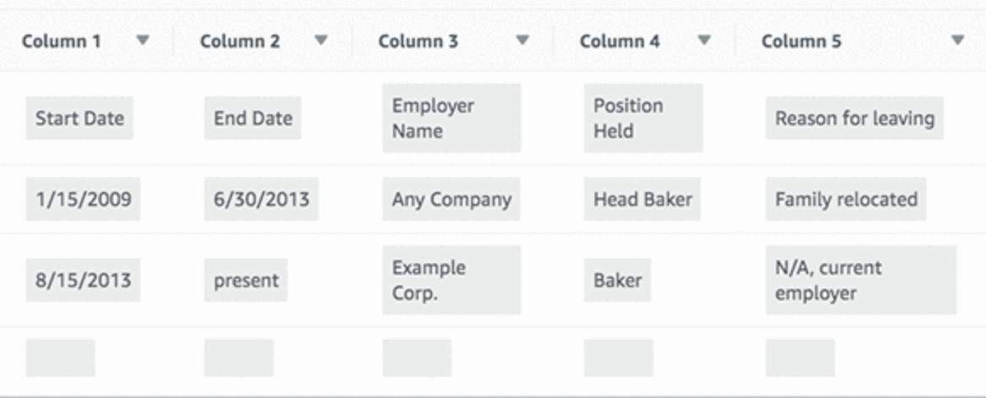
Optical Character Recognition

Slide 9
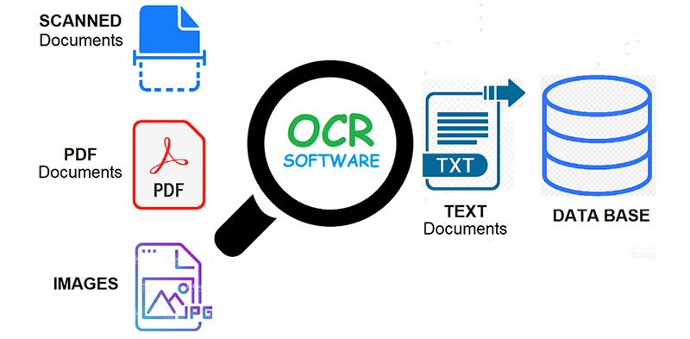
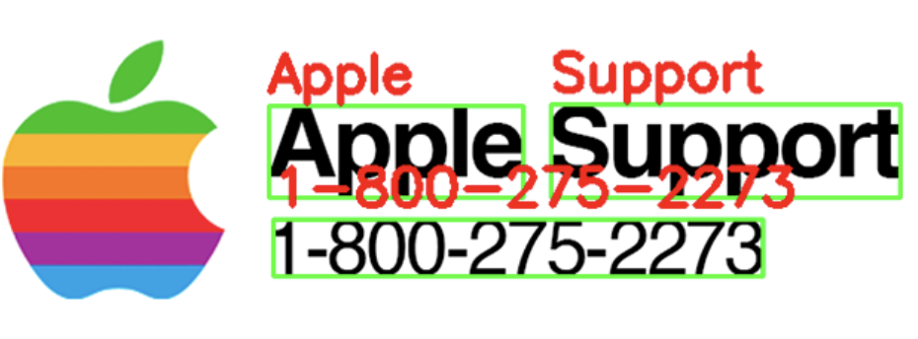
Use Case – Optical Character Recognition
Optical Character Recognition
Conversion of of images of typed, handwritten or scanned documents into machine-encoded text
Extract Text From:
Scanned Documents
PDFs
Handwritten Notes
Images

Slide 10
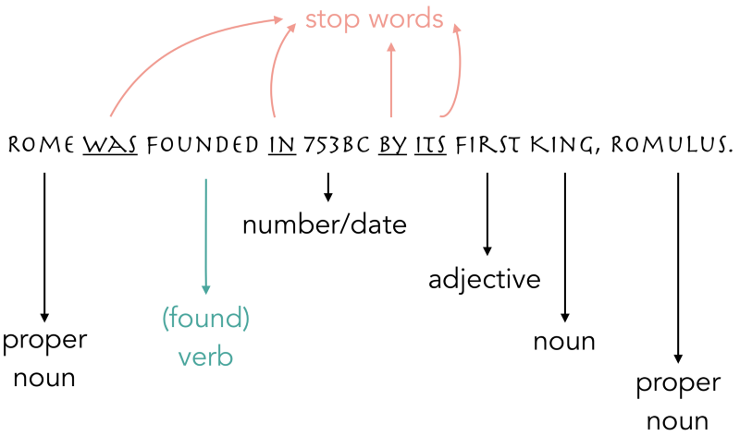
Use Case – Natural Language Processing
Natural Language Processing
”Understanding" documents from the text along with contextual nuances. NLP can also extract information from the text, as well as categorize and organize the documents.
Example Uses:
Automated Reports
Email Generation
Chat Bots
Sentiment Analysis (+ or -)
Document Summaries
Data Entry Validation/Comparison

Slide 11
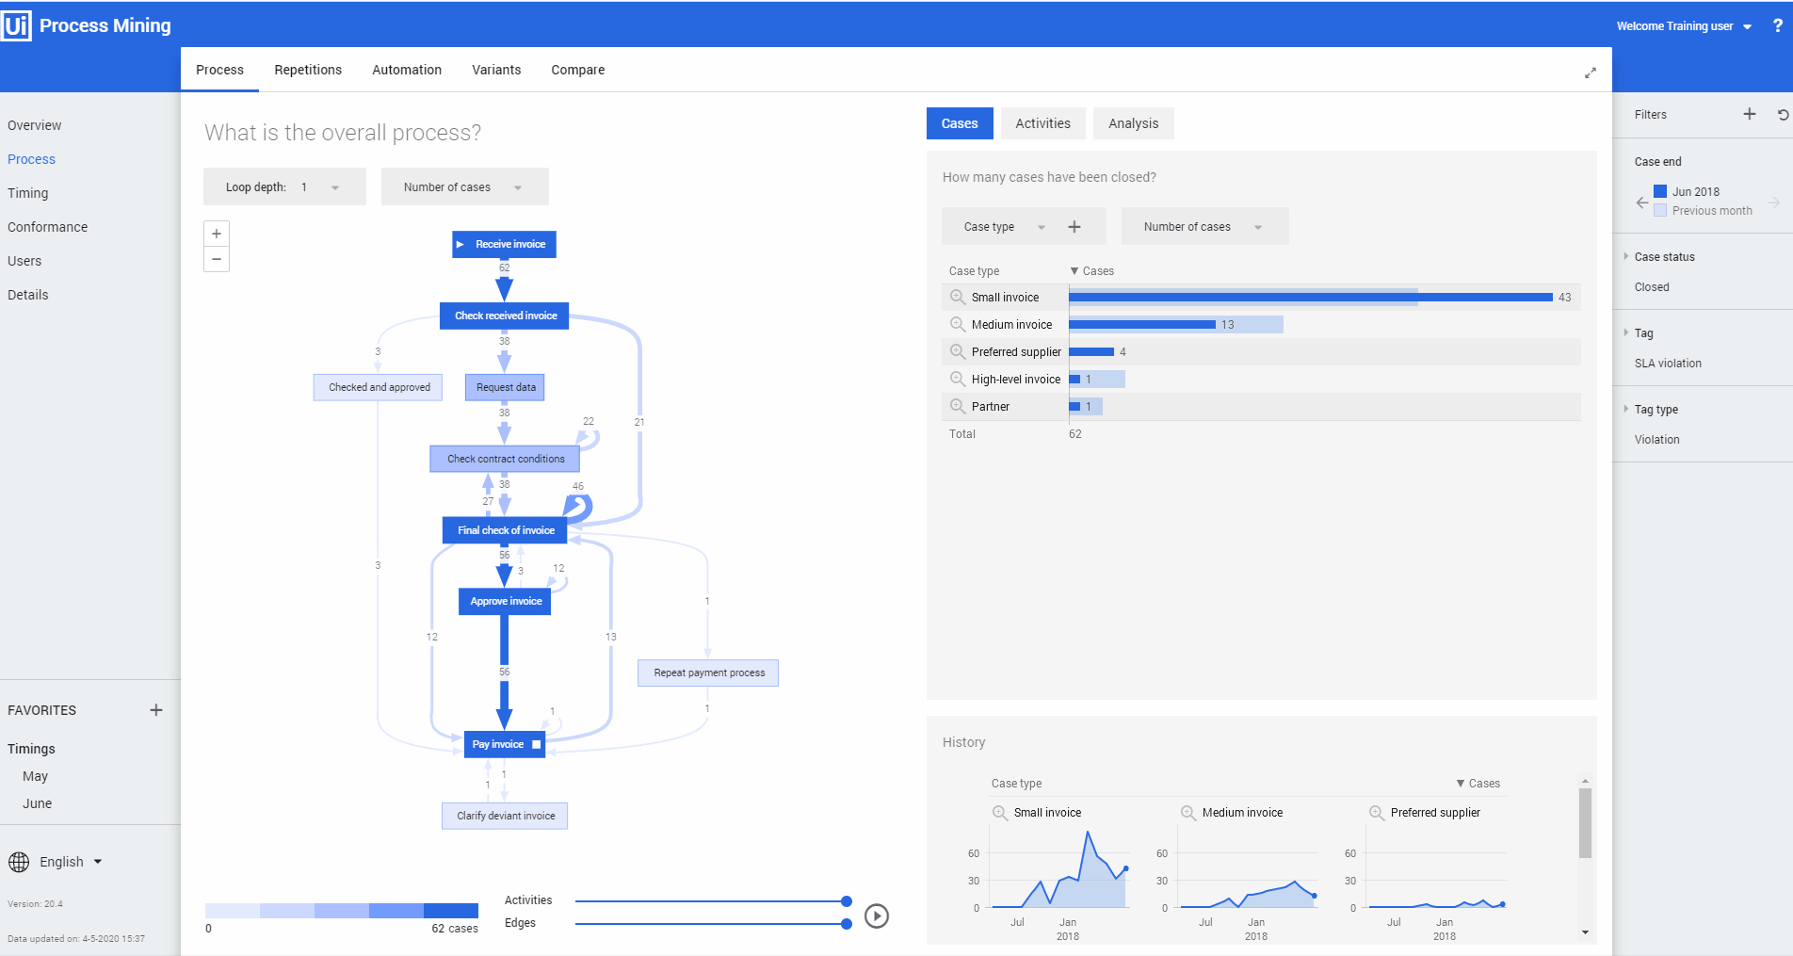
Use Case – Task Mining
Automatically generates an event log for tasks to derive an end-to-end process of a recorded task in a visual workflow for monitoring and analysis.
Capture
Clicks, typing, scrolls, user actions, time-stamps and screenshots
Add business context
Collect words, numbers and text to contextualize actions
3. Match to business data
Add User IDs to recordings to correlate user interactions with sales
4. Optimize outcomes
Uncover inefficiencies in patterns and optimize productivity

Slide 12

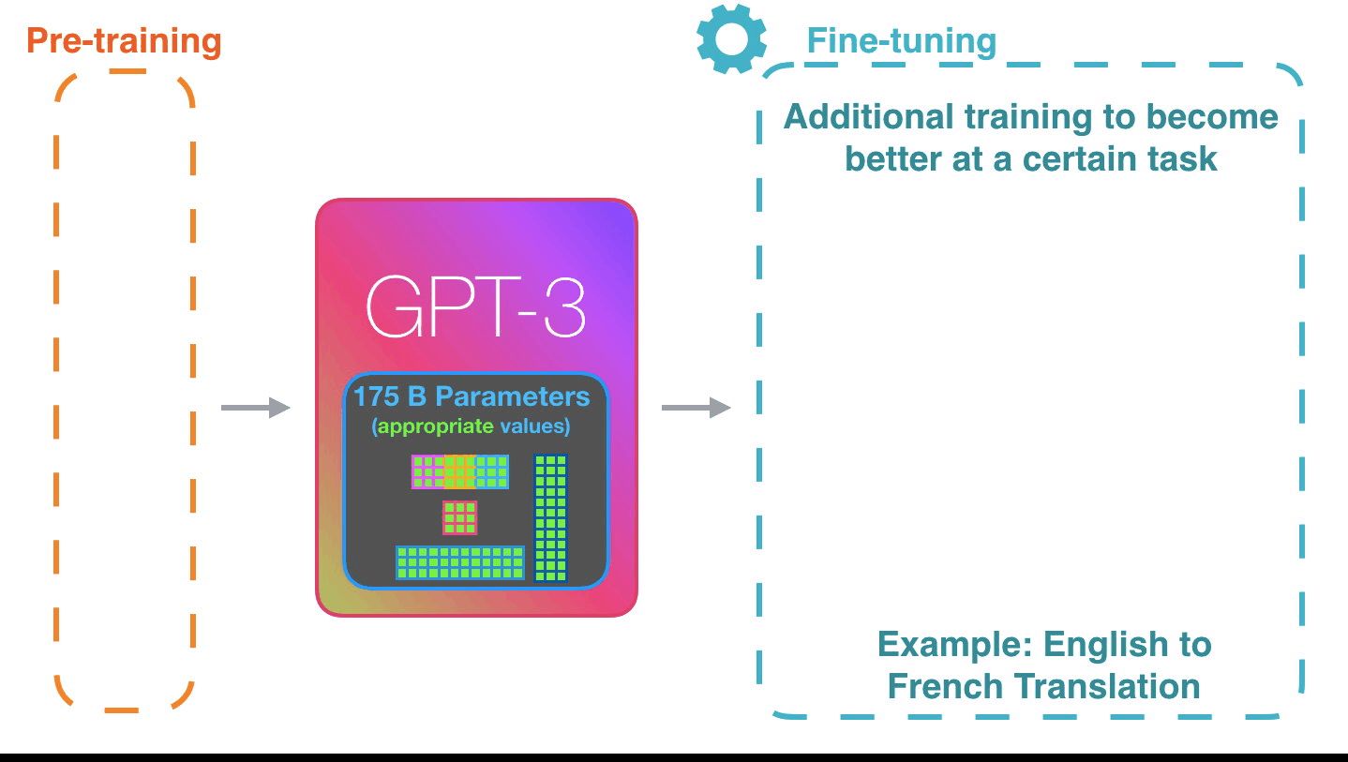
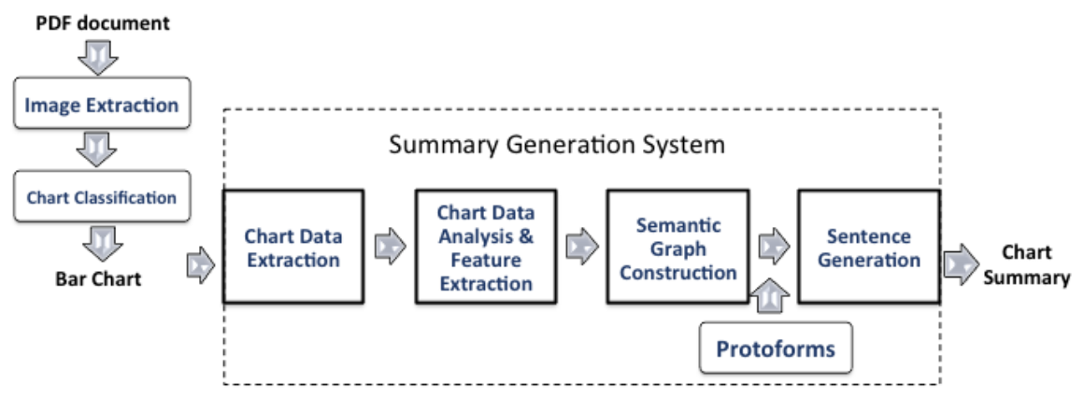
Recent Advancements
Predictive RPA Solutions
Plain English → Speech-to-text → GPT-3 language model → RPA code
Combination of Tools

Slide 13

Current Strengths & Limitations
Strengths
Keyboard & Mouse Automation
Freeing up employees, Increase Task Speed
Decrease Hours & Human Error Reduction
Open Source & Proprietary Tools
Low-code & No-Code Options
Limitations
Changing Decisions Without Predefined Rules
Changes in Workflow Requires Human Involvement
Error Magnification
Long-Term Sustainability & Task Maintenance Risk

Slide 14
References & Resources
RPA Overviews
https://www.nice.com/rpa/rpa-guide/the-benefits-of-rpa/
https://intellipaat.com/mediaFiles/2019/02/RPA-Cheat-Sheet.pdf
Corporate Offerings
https://www.automationanywhere.com/
https://www.uipath.com/
https://www.blueprism.com/
Python Programs
https://github.com/asweigart/pyautogui/
https://github.com/tebelorg/RPA-python
Summarizing images of graphs: https://www.aaai.org/ocs/index.php/WS/AAAIW16/paper/viewFile/12661/12436
Task mining: www.Uipath.com
GPT-3: https://openai.com/blog/openai-api/
Predicting mouse movements: https://towardsdatascience.com/mouse-movement-modelling-to-predict-online-fraud-873d90b201e2
NLP: https://becominghuman.ai/a-simple-introduction-to-natural-language-processing-ea66a1747b32
OCR: https://towardsdatascience.com/a-gentle-introduction-to-ocr-ee1469a201aa
Text Extraction: https://monkeylearn.com/blog/text-classification-vs-text-extraction/
Computer Vision: https://machinelearningmastery.com/what-is-computer-vision/

